Slide 1
COGS 138: Week 2 Section
January 12th, 2021

Slide 2
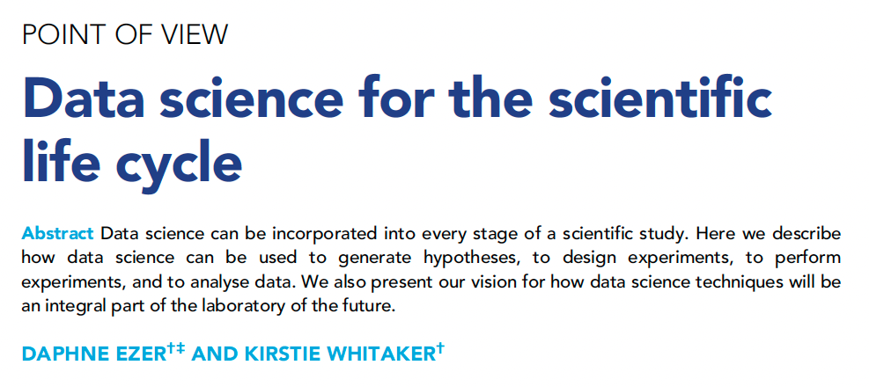
Reading #1:

Slide 3
First, what is data science?
A ‘framework’ for solving problems
Tends to use larger datasets
Using predictive models on current data to ask questions about other data
“develop[ing] new computational or statistical analysis techniques that can easily be adapted to a wide range of scenarios, or apply[ing] these techniques to answer a specific scientific question”

Slide 4
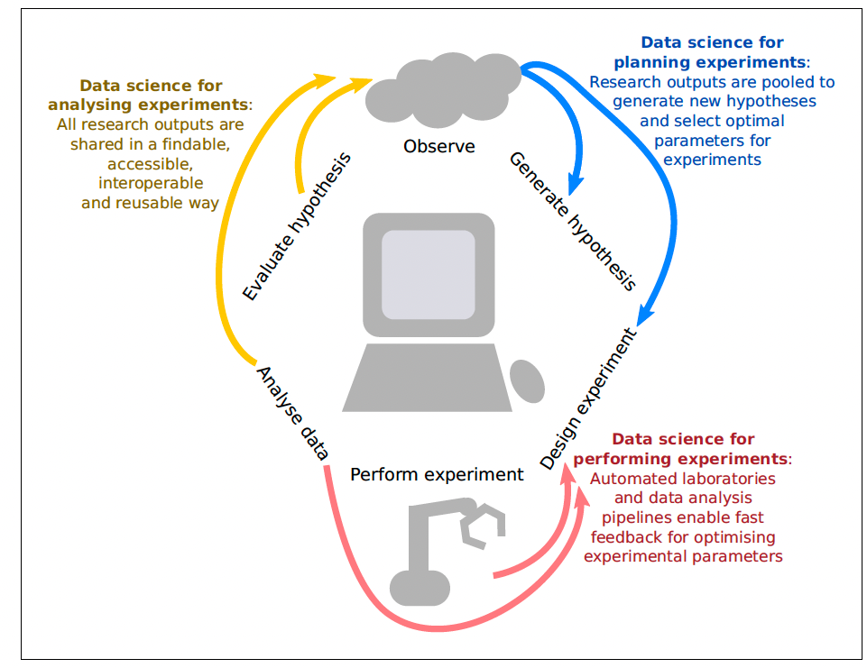
How can we apply the framework of data science to scientific research?

Slide 5
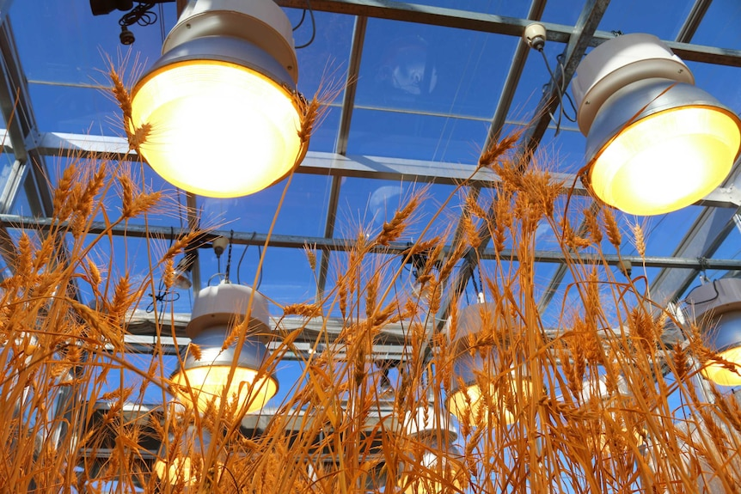
Data Science for Planning Experiments
Scientific questions → Optimization problems
Tweak parameters of your experiment, then iterate
Example: Fit a model of how temperature and light exposure influence wheat growth
What unforeseen aspects of this experiment may influence the results?
Notes:
Hypothesis-driven research usually requires a sci-
entist to change an independent variable and
measure a dependent variable. However, there
are often too many parameters to take account
of. In plant science, for instance, these parame-
ters might include temperature, exposure to
light, access to water and nutrients, humidity
and so on, and the plant might respond to a
change in each of these in a context-dependent
way.
For instance, let us say that a scientist wants
to fit a regression model of how temperature
and light exposure influence wheat growth. Ini-
tially they might measure the height of the
wheat at a number of combinations of tempera-
ture and light exposure. Then, the scientist could
ask: what other combinations of temperature
and light exposure should I grow the wheat at in
order to improve my ability to predict wheat
growth, considering the cost and time con-
straints of the project?

Slide 6
Data Science for Planning Experiments
Main Takeaways:
Statisticians/Data Scientists should be involved in the experimental design process early on
The data/software/protocols are just as important as the results!

Slide 7
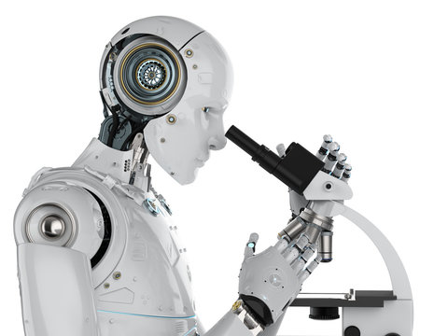
Data Science for Performing Experiments
Laboratory automation via “ROBOT SCIENTISTS”
They “use machine learning to generate hypothesis, plan experiments, and perform deductive reasoning to come to scientific conclusions”
Formal language to report scientific results
Improves reproducibility
Iterative workflows
Data collected by robots should be used to plan the next experimental procedure

Slide 8



Data Science for Reproducible Data Analysis
How to aim for full replication when publishing scientific results:
Interactive notebooks
Jupyter, Rmarkdown
Version control and collaboration
Git, GitHub, GitLab
Package managers
Conda, Docker
Workflows
Travis CI
Open-source software and data
Open Microscopy Environment (OME)
FAIR: Findable, Accessible, Interoperable, Reusable

Slide 9
Data Science for Hypothesis Generation
We should be utilizing technology and data science to create new ideas!
Humans have a limited set of knowledge as well as unconscious biases
“...machine learning techniques such as text mining of published abstracts or electronic health records (Oquendo et al., 2012), or exploratory meta-analyses of datasets pooled from laboratories around the world, can be used for automated, reproducible and transparent hypothesis generation.”

Slide 10
Challenges of Translating Theory into Practice
Interpreting experimental outcomes
Machine-readable --> human-readable
Positive feedback loops and algorithmic bias
Using the same model organisms because that is what our predecessors used
Algorithmic bias due to biased input data
Implementation and training
Version control, programming languages, statistics, robotics engineering
Infrastructure and accessibility
Augmentation, not automation
Data science as supplementing human research, not replacing it
Less ‘busy work’, more uniquely human thinking

Slide 11
Challenges of Translating Theory into Practice
Any other challenges you can think of?

Slide 12
General Announcements and Reminders
A0 and A1 due this Friday (1/14/22) at 11:59 PM (PST)
Sorry about weird technical issues
Let us know if these persist for future assignments
Reading Quiz due next Friday (1/21/22) at 11:59 PM (PST)
Three attempts
We will grade your last attempt, not your best attempt

